Slide 1
Garbage Monitoring System
B. Pranavnath – 1602-16-737-028
S. SaiTeja – 1602-16-737-305
R. JashwanthYadav – 1602-16-737-018

Slide 2
ABSTRACT
Garbage monitoring system will help to keep the cities clean. This system monitors the garbage bins and informs about the level of garbage collected in the garbage bins via a web page. For this the system uses ultrasonic sensors placed over the bins to detect the garbage level and compare it with the garbage bins depth.

Slide 3
USE CASES
This system gives a real time indicator of garbage level in a trashcan at any given time.
The proposed system is cost effective because it will notify twice to the organization and they will get time to optimize the cost of transportation.
This project will help to eradicate or minimize the solid waste disposal problem.

Slide 4
TECHNOLOGY USED
UBIDOTS: Ubidots is another interesting IoT platform that provides several services. First of all, it supports several devices, such as Arduino, Raspberry, Particle, Espressif, Onion, and much more. Moreover, it has different kinds of services, ranging from device connectivity to data visualization

Slide 5
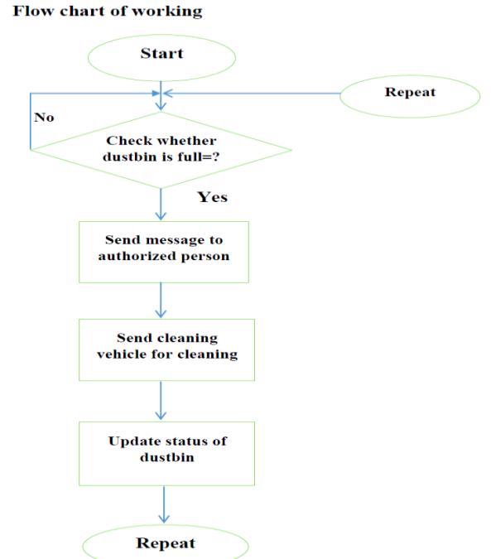
FLOWCHART

Slide 6
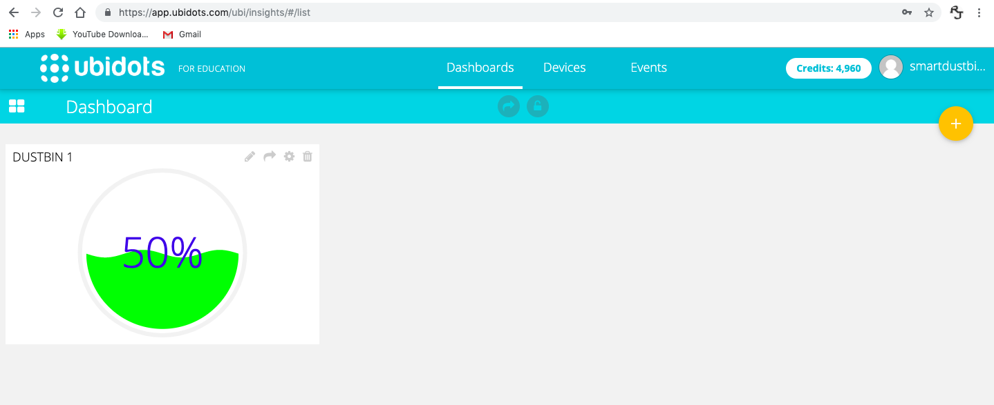
RESULT

Slide 7
CONCLUSION AND FUTURE WORK
The main aim of this project is to reduce human resources and efforts along with the enhancement of a smart city vision. We have often seen garbage spilling over from dustbins on to streets and this was an issue that required immediate attention. The proverb “Cleanliness is next to god and clean city is next to heaven” inspired us to conceptualized the project. Smart dustbin helps us to reduce the pollution.

Slide 8
THANK YOU

